Slide 1
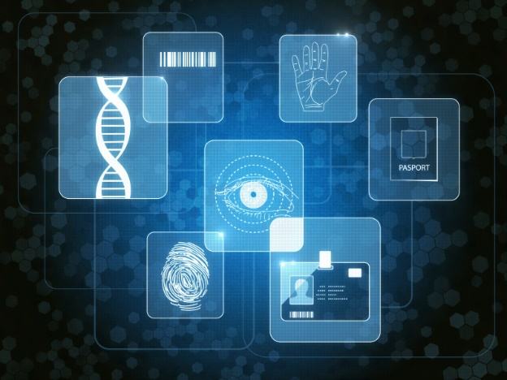
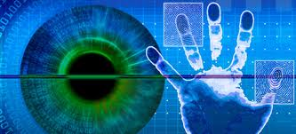
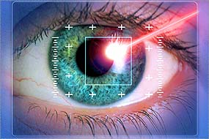
Impact of Blinking on Deep Learning Iris Recognition
Daniel Tebor, Eli Headley, and Mahmut Karakaya
Dept. of Computer Science
Kennesaw State University
April 19, 2024

Slide 2
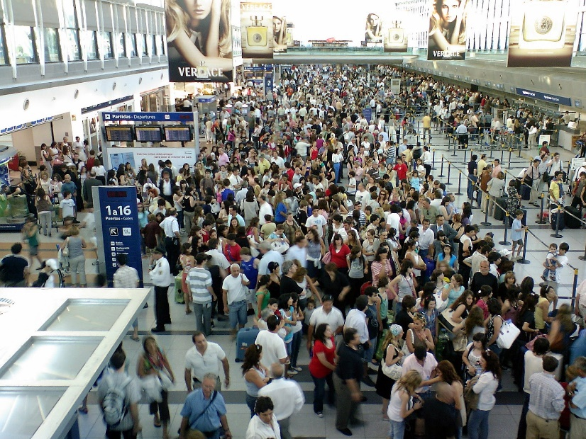

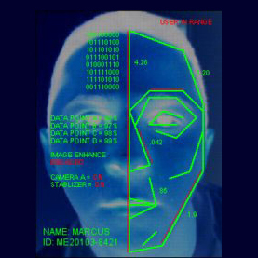
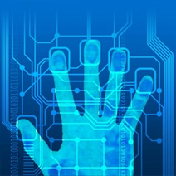
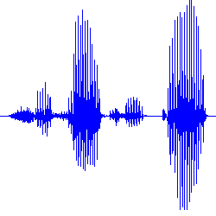
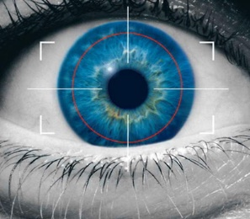
Motivation for Biometrics
The identity management to strengthen global security.
Subject credential is important.
With millions of people passing sensitive locations ever day.
The need of high efficiency access control.
Biometrics used broadly as the technology to verify the identification.
The use of biometric systems becoming increasingly common.

Slide 3
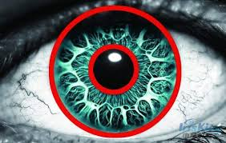
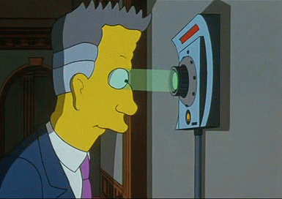
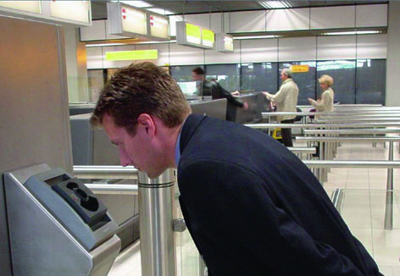
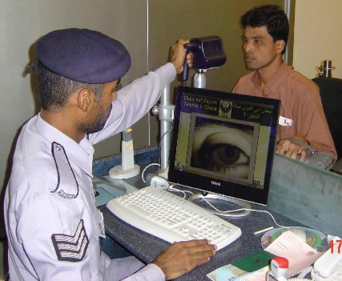
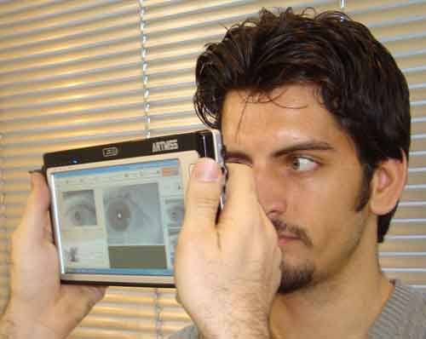
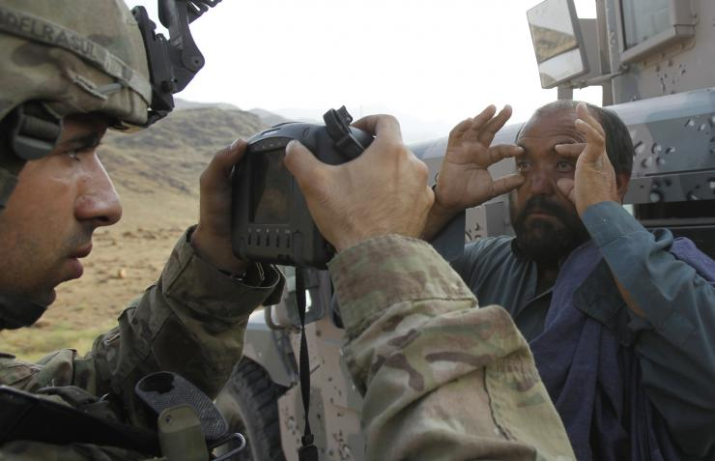
Why Iris Biometrics?
IRIS:
Colored part of the eye.
Unique and most stable biometrics in the human body.
More accurate biometrics than fingerprint or face.
Iris recognition providing
Strong security,
Higher usability,
Nonintrusive.
Despite the superiorities, not widely used due to its cumbersome and time-consuming procedures.

Slide 4
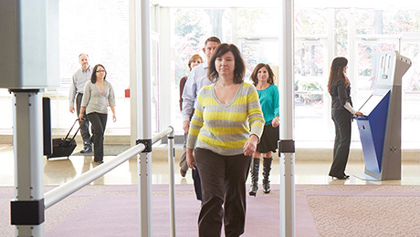
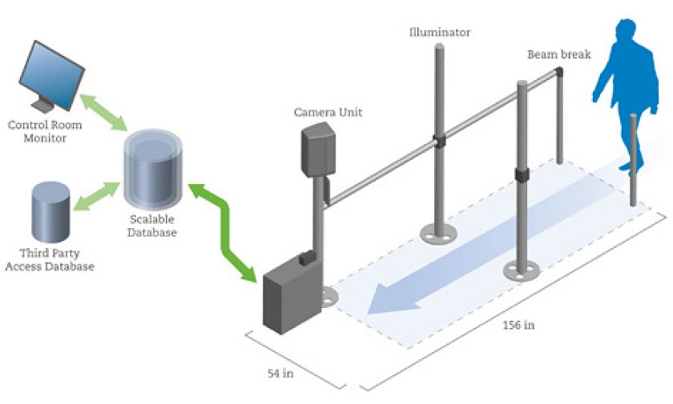

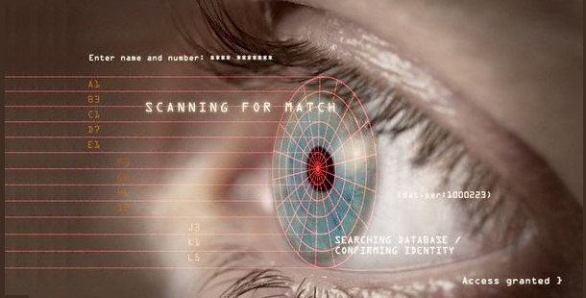
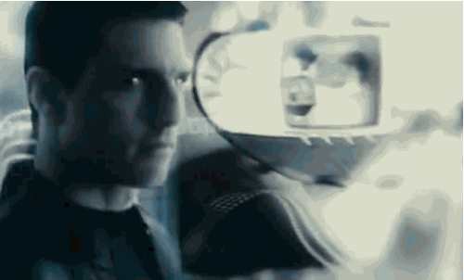
Stand-off Iris Recognition Systems
Stand-off Biometrics System Benefits:
Non-intrusive. Camera is positioned several feet away from the subject and only requires a glance.
High throughput. System can process multiple subjects at once.
Perfect for any access control application;
airport, border crossing, point of sale.
Subject can move freely without stopping.

Slide 5
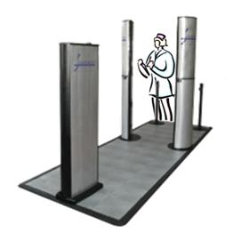
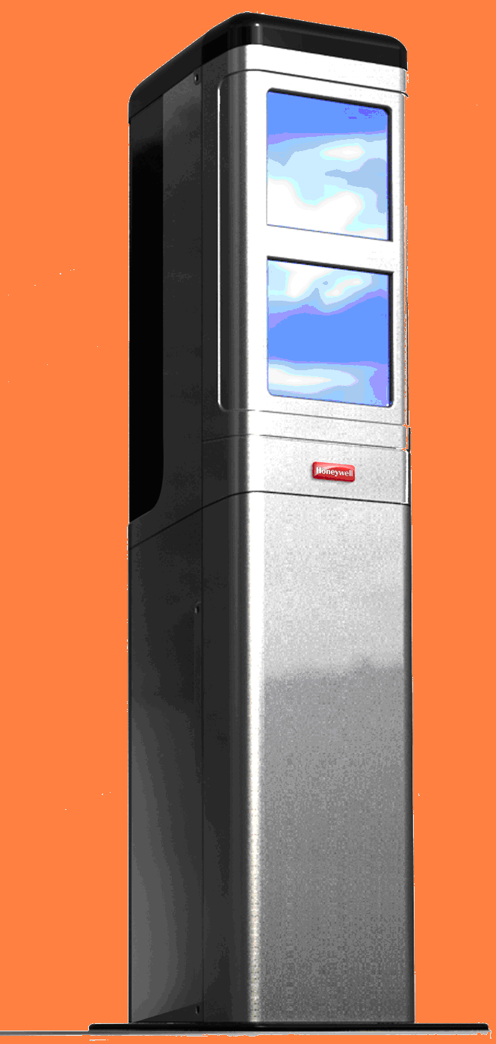
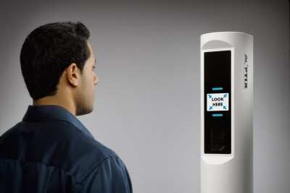
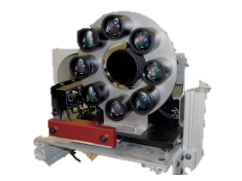
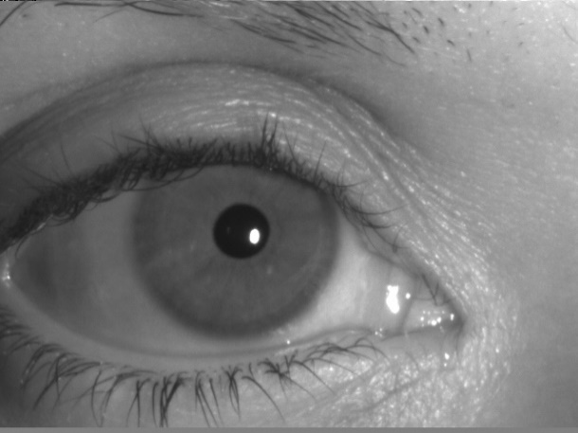
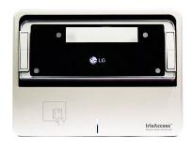
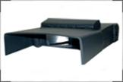
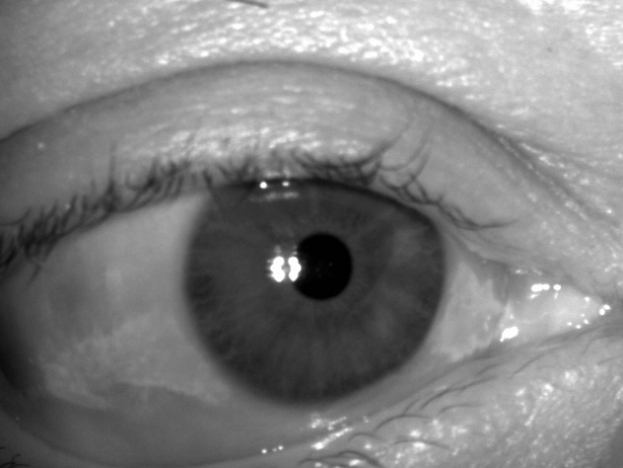
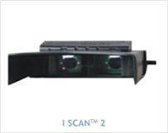
Existing Stand-off Iris Recognition Systems
Iris On the Move PassPort™ (Sarnoff)
Honeywell CFAIRS
ORNL Standoff Multimodal Biometric System
AOptix Iris Scanner
LG IrisAccess
ISCAN 2

Slide 6
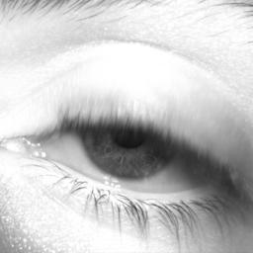
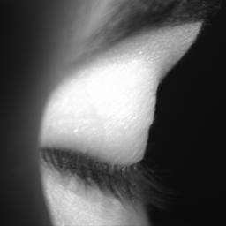
The Blinking Problem
Blinking and iris occlusion in-general masks the salient regions of the iris.
Impact on results for both traditional and deep learning methods.
A robust system must be able to either reject blinked images and/or be resistant to its effects.
Measuring the effects of blinking is important for developing resilient stand-off iris recog. systems.
Blinked iris
Notes:
However, the captured iris image determines the accuracy of the recognition systems.
With a less restrictive environment, where the subject has the ability to move about freely, the majority of images captured are considered non-idea. Non-ideal images include images with a lack of pixels, eyelid/eyelash occlusions, specular refraction, and blur. Here you can see a blur present in the iris section cause by a shift eye focal point location within first image on the left. Middle image demonstrates and example of an eyelid occlusion which is covering slightly under half the iris and the last image on the right displays an eyelash occlusion where eyelashes can bee seen intruding upon the iris pattern area
Other challenges when dealing with off-angle iris images, unlike frontal images, are several distortion issues. Including gaze angle which can cause corneal refraction limbis occulations and depth of filed blue,
for example we will look at limbus occulstion, the lumbus separates iris from sclera, but is not part of the iris texture. When comparing the frontal and off agnle images, The depth of the limbus in the frontal vs the off angle provided is smaller and therefore must be accounted for or the iris pattern is going to be distorted by the limbus if catured during segmentation.
for example, if you look at the frontal and iris images on this slide
Another distortion cause by a difference in gaze angle is the overall shape of the iris itself,
when you look at the frontal images vs the off angle images on this slide. You can see a change in iris shape, where the frontal image is circular while the off angle image is elliptical.
pupil dilation is another common issue when dealing with off-angle images which results in a 3D iris texture and occulstions. when comparing the conststritcted iris image vs the dilated iris image provided there can be seen a change in the 3D iris texture.
another challenge present is when there are
“Changes in contraction of the ciliary muscles where the focal distance of the eye altered, causing nearer or farther images to come into focus on the retina; known as lens accommodation.
There are two favored solutions for off angle iris recognition 1 and 2. Which I will be analyzing and comparing in this power. These solutions presented poor recognition beyond that of 30 degree. According to research up to date there is no comprehensive framework dedicated to handling the recognition of off-angle iris images. I will be analyzing the two different approaches in the two slides.

Slide 7
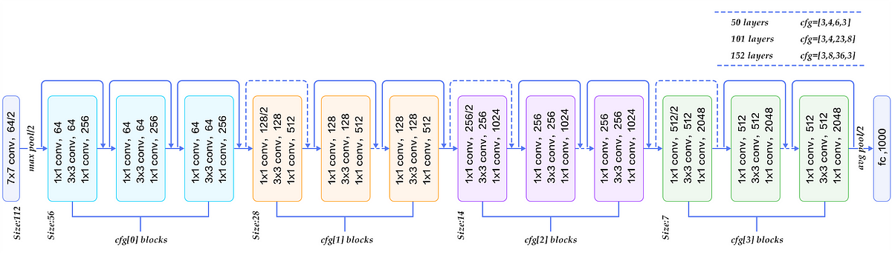
Deep Learning Iris Architecture
Previous research showed that the CNN ResNet50 was an excellent choice for out-of-box subject classification.
Transfer learning utilized by replacing the final layer to predict 101 classes instead of 1000 and then retraining the model.

Slide 8
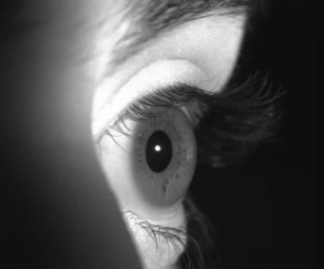
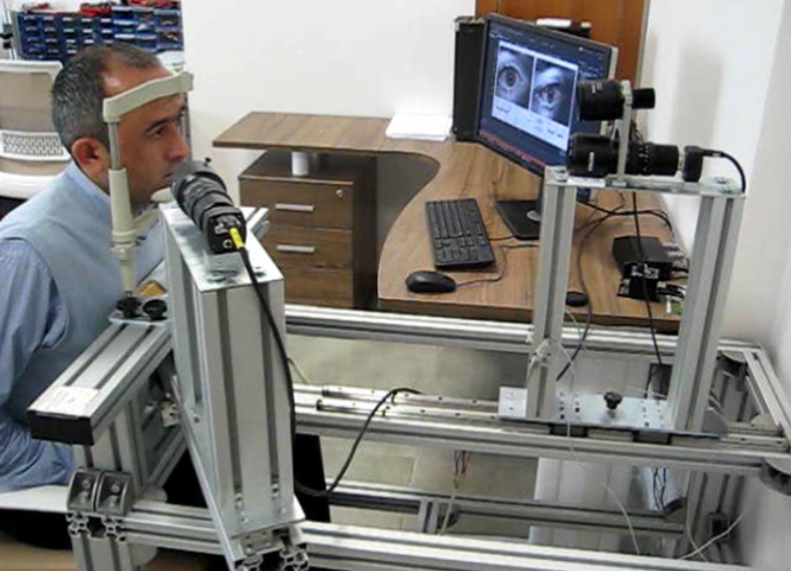
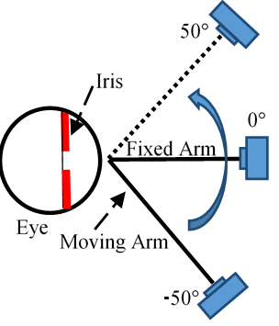
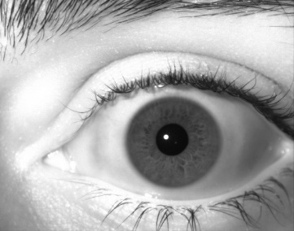
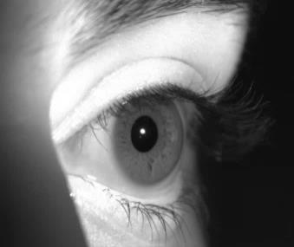
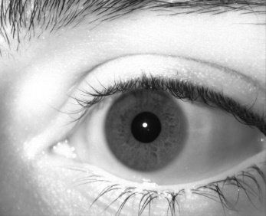
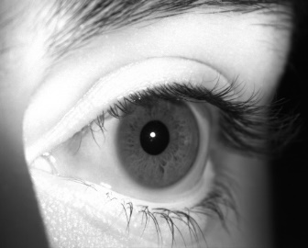
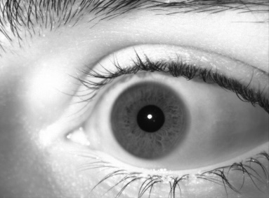
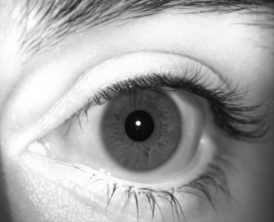
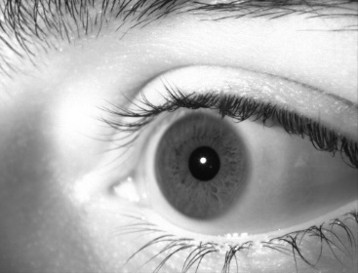
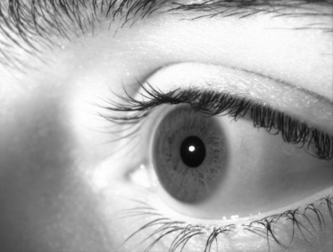
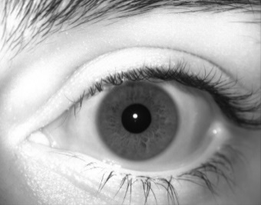
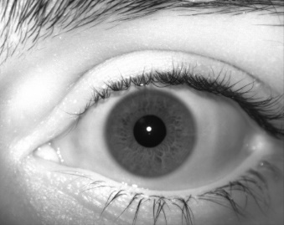
Original Dataset
+50$°$
-10$°$
+40$°$
-20$°$
+30$°$
-30$°$
Iris Dataset:
6500 iris images from 113 different subjects,
Camera:
60 images per second (1280x1024) with NIR sensitivity,
Fontal and Off-angle camera at 108 mm and 40mm focal length.
Setup:
Each subject placing their chin into a chin rest with a forehead support,
Frontal camera captures frontal iris images
Off-angle camera captures off-angle iris images.
Off-angle camera rotates from -50º to 50º with the increment of 10º.
+20$°$
-40$°$
+10$°$
-50$°$
0$°$

Slide 9
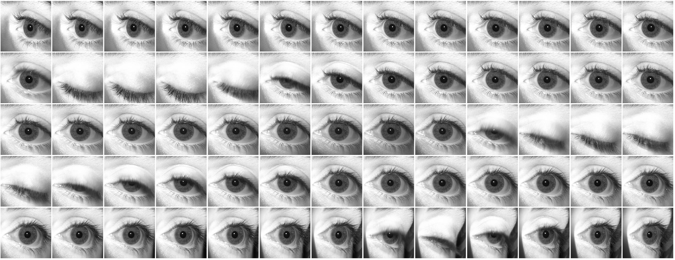
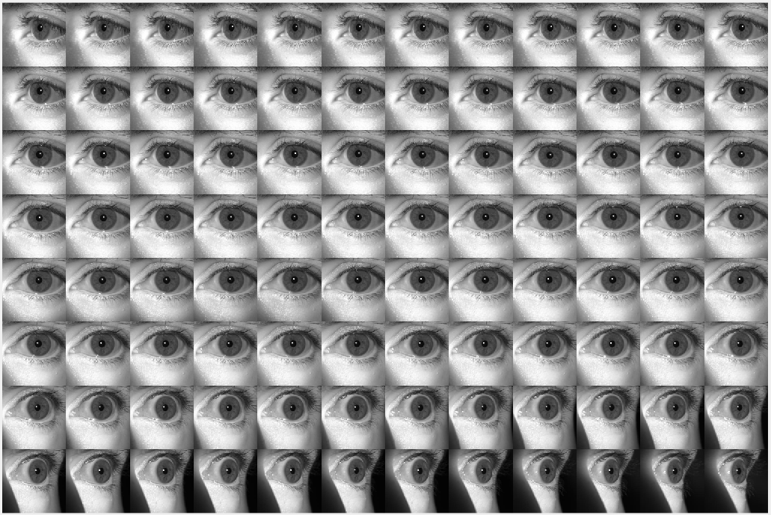
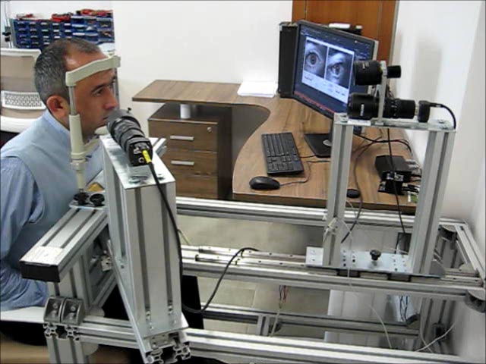
Iris Data Collection Platform

Slide 10
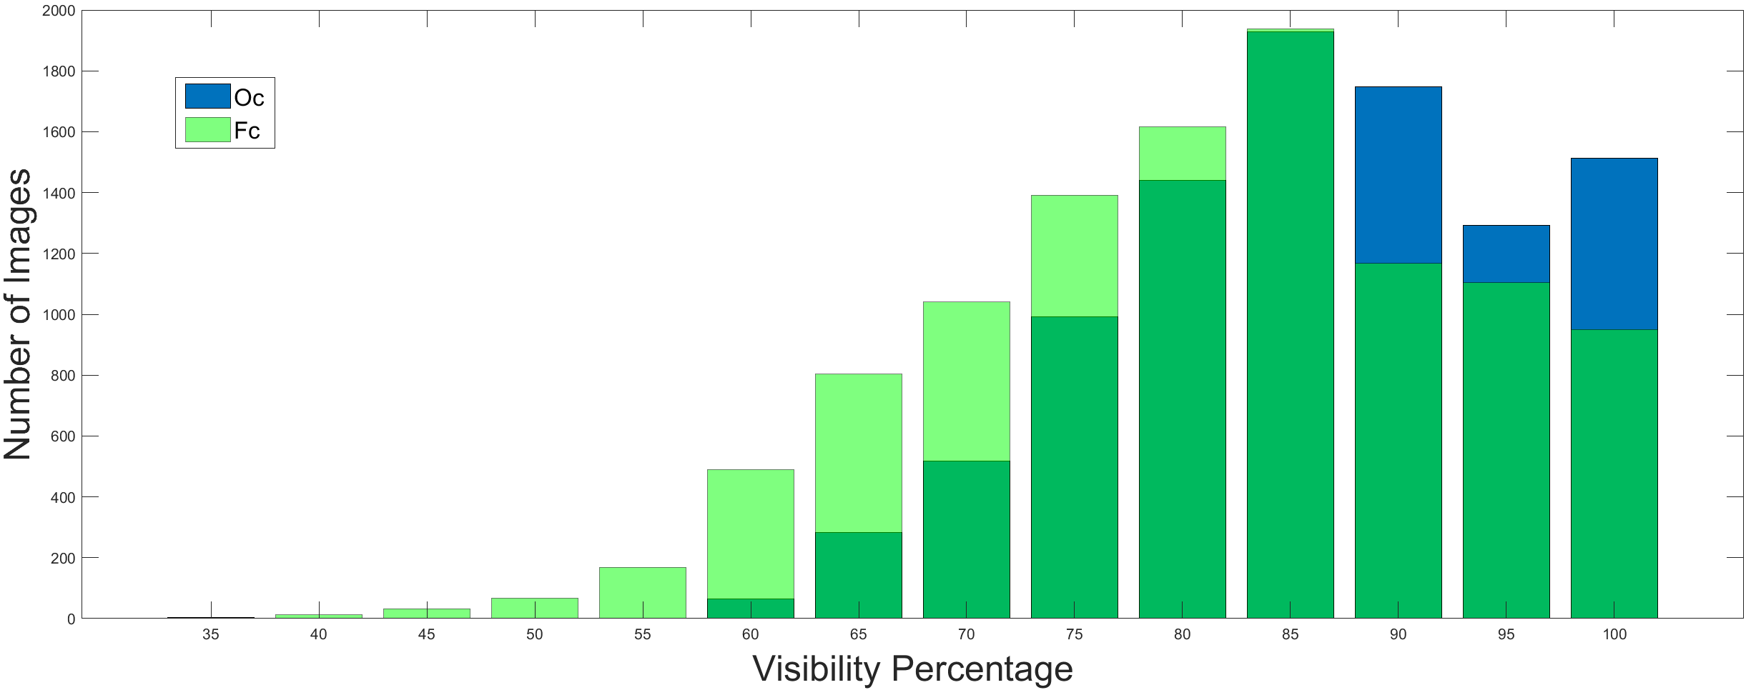
Distribution of Occlusion in Dataset

Slide 11
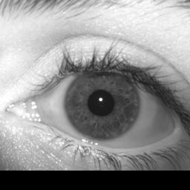
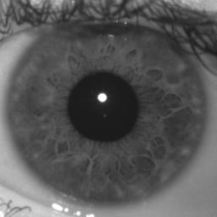
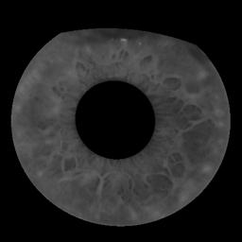
Relevant Cohorts
Three cohorts: Periocular, Ocular, and OcularIris.
Periocular – iris and surrounding features.
Ocular – iris takes up most of image with other close features still visible.
OcularIris – iris is segmented, and all other features are masked.
Periocular Ocular OcularIris

Slide 12











Synthetic Blinking Flowchart
+0% +10% +20% +30% +40% +50% +60% +70% +80% +90%

Slide 13
Experimental Design
The synthetically blinked dataset gives us access to cohorts with different levels of occlusion (0% to 90%).
Important to note that low occlusion cohorts (0%, 10%, etc.) have reduced # of images due to original distribution of occlusion.
Four experiments:
Model trained on only the original OcularIris dataset.
Model trained on original OcularIris dataset AND the 0-30% occlusion cohorts.
Model trained on original OcularIris dataset AND the 0-60% occlusion cohorts.
Model trained on original OcularIris dataset AND the 0-90% occlusion cohorts.
All models trained using ONLY frontal images.
Frontal images, including the occlusion cohort images, were captured by the frontal camera.
Models evaluated using each occlusion cohort.
Frontal images from the orbital camera used resulting in images taken at a different time than what model was exposed to during training.

Slide 14
Hyperparameters & Image Augmentation
Models trained using mini-batch gradient descent.
Training continued until the testing loss stopped improving.
Weights used were from the best epoch.
Testing dataset same as validation dataset.
All images resized to 224x224 and normalized to ImageNet specifications (mean[0.485, 0.456, 0.406], std dev[0.229, 0.224, 0.225]).
Training images used augmentations applied before resizing and normalization.
Batch Size | LR | Momentum | Weight Decay
128 | 0.01 | 0.9 | 2e-5
Training Augmentations
Random -10% to 10% X and Y translation
Random -20° to 20° rotation
Gaussian blur with kernel size 3 and sigma of 0.1 to 0.5

Slide 15

Baseline Model
Linear decrease in performance as occlusion increases.

Slide 16

Original AND 0-30% Occlusion Cohorts
Slight improvement over baseline.

Slide 17

Original AND 0-60% Occlusion Cohorts
Major improvement, with only 80% and 90% occlusion showing poor results.

Slide 18

Original AND 0-90% Occlusion Cohorts
All occlusion levels show high accuracy, but lower levels of occlusion take a performance hit.

Slide 19




Baseline Model
0% Occlusion Hist
30% Occlusion Hist
60% Occlusion Hist
90% Occlusion Hist

Slide 20




Original AND 0-30% Occlusion Cohorts
0% Occlusion Hist
30% Occlusion Hist
60% Occlusion Hist
90% Occlusion Hist

Slide 21




Original AND 0-60% Occlusion Cohorts
0% Occlusion Hist
30% Occlusion Hist
60% Occlusion Hist
90% Occlusion Hist

Slide 22




Original AND 0-90% Occlusion Cohorts
0% Occlusion Hist
30% Occlusion Hist
60% Occlusion Hist
90% Occlusion Hist

Slide 23
Closing Remarks
What was proposed:
Test the effects of blinking on deep learning-based iris recognition and improve performance.
How it was done:
Using transfer learning to train ResNet50 on a synthetically occluded dataset.
What were the findings:
Performance linearly decreases as occlusion increases.
Augmenting the dataset with synthetically occluded images significantly improves performance
Augmenting with too high of an occlusion can degrade performance at lower occlusion. A good sweet spot is up to 60-70% occlusion
Limitations:
Model forced to only consider features in a narrow section of iris.
Results may not be reflective of a substantially larger dataset.
It may be more ideal to use features around the iris.

Slide 24

Questions?

